Slide 1



Slide 2
Land Acknowledgement
Simon Fraser University, AIESEC in SFU, and Data Science Student Society respectfully acknowledges the unceded traditional territories of the Coast Salish peoples, including the səlilwətaɬ (Tsleil-Waututh), kʷikʷəƛ̓əm (Kwikwetlem), Sḵwx̱wú7mesh Úxwumixw (Squamish) and xʷməθkʷəy̓əm (Musqueam) Nations, on which SFU Burnaby is located.

Slide 3
Housekeeping
Notes:
Double click the text box to change the text.

Slide 4
Final Hour To Complete Presentation
PLEASE RETURN TO YOUR SEATS BY 1PM
Notes:
Double click the text box to change the text.

Slide 5
Opening Ceremony
Notes:
Double click the text box to change the text.

Slide 6
Introducing the DSSS
The SFU Data Science Student Society (DSSS) is a student-run organization dedicated to fostering a community of data-driven thinkers.
Through workshops, networking events, and industry partnerships, we help students develop skills in data science, machine learning, and analytics while exploring career opportunities in the field.
The DSSS represents and promotes the interests of students in the SFU Data Science Department.

Slide 7
Introducing AIESEC
AIESEC is the world’s largest youth led not-for-profit organization, with partners from over 120 countries.
AIESEC SFU is affiliated with the Beedie School of Business and the United Nations.
AIESEC focuses on leadership development through international exchange opportunities that we provide.
AIESEC offers international teaching, internship, and volunteer exchange opportunities to individuals who are 18-30 years old.

Slide 8




Today you will be…
Tackling a Real-World Challenge
Sharpening Problem-Solving & Analytical Skills
Networking with Industry Professionals & Peers
Building a Portfolio Project

Slide 9
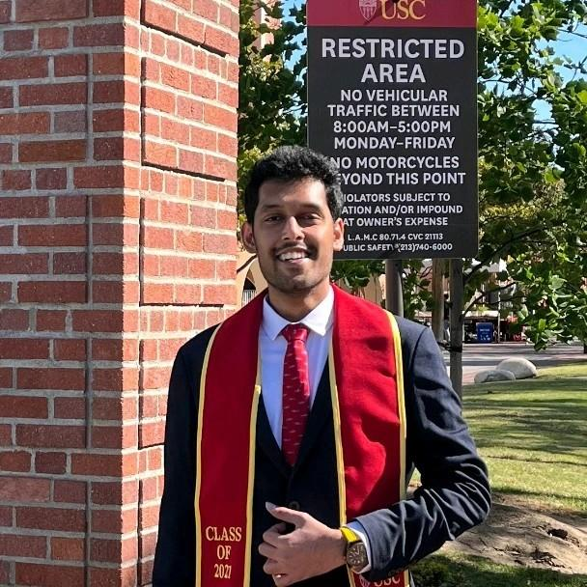
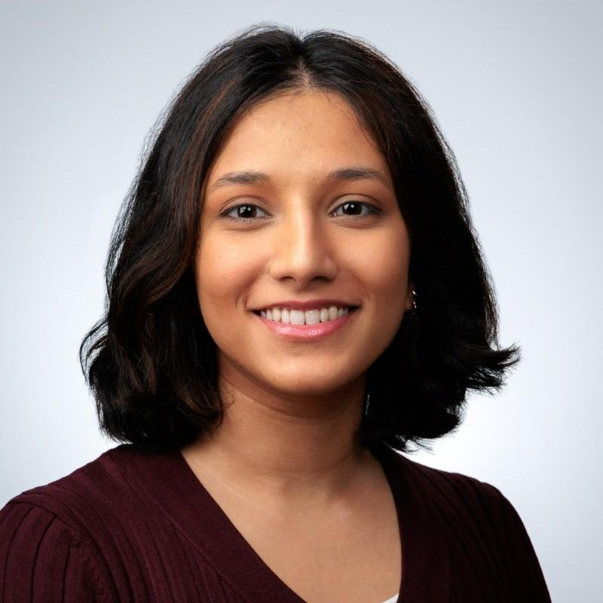
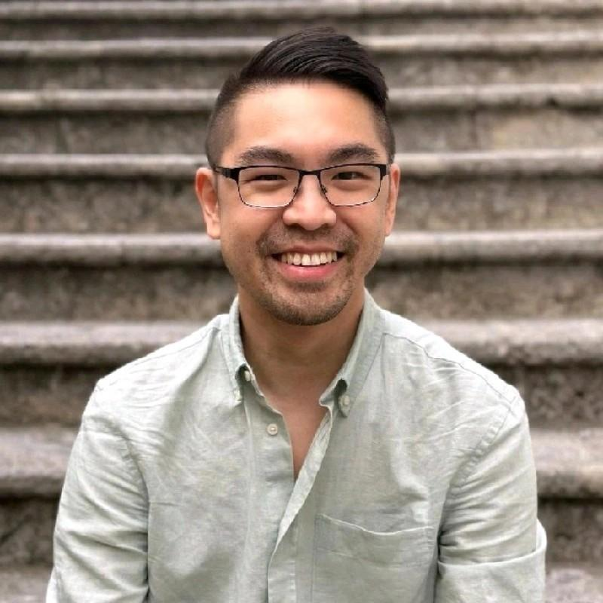
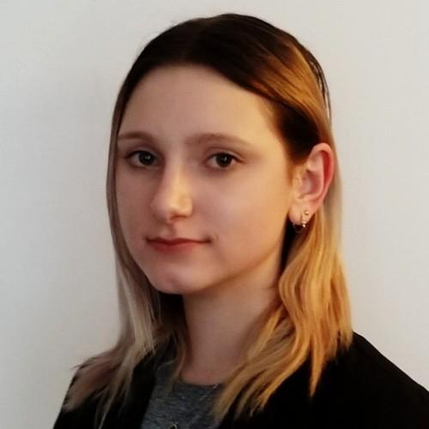
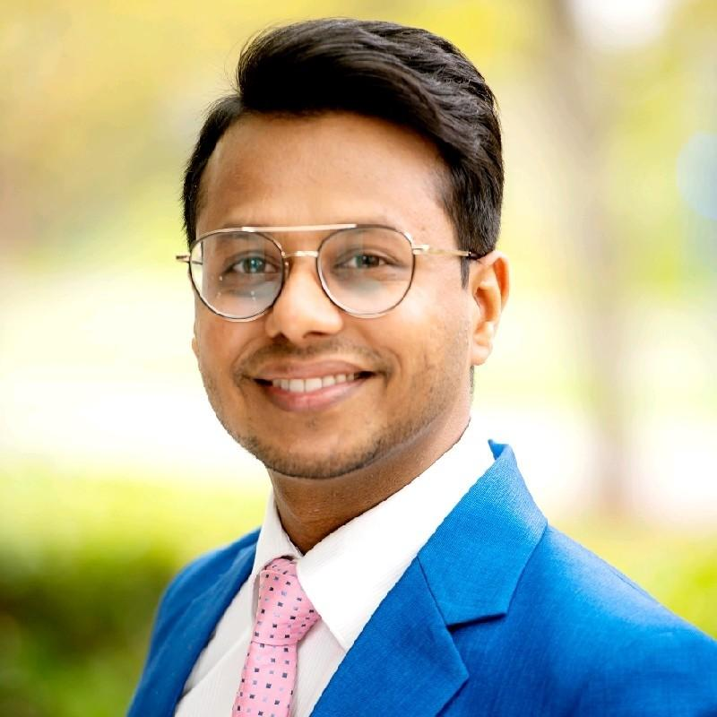
Introducing Our Judges
Devansh Shah
Nabila Doctor
Alex Juy
Sarah MacDonald
Utkarsh Bansal
Data Scientist
Business Analyst
Senior Principal Product Manager
Decision Support Advisor
Managing Consultant
Microsoft
Providence Health Care
MacroHealth
Vancouver Coastal Health

Slide 10
Event Timeline
11:30 AM
Check-In & Registration
1:00 PM
Opening Ceremony & Event Briefing
1:30 PM
Hacking Session - Phase 1
3:30 PM
Lunch Break & Networking
4:20 PM
Hacking Session - Phase 2 &
oGX Presentation
5:00 PM
Final Team Presentations
6:00 PM
Winner Announcements
6:15 PM
End of Event

Slide 11
HACKING SESSION 1
Notes:
Double click the text box to change the text.

Slide 12
Judging Criteria and Scoring
Judges will evaluate each team based on four key categories, totalling 100 points:
Category | Weight (%) | Evaluation Criteria
Data Analysis & Visualization | 30% | Depth of insights, accuracy, trend identification, and data interpretation
Guidelines Adherence | 5% | Compliance with all submission guidelines.
Strategic Recommendations | 35% | Practicality, innovation, and feasibility of proposed solutions for AIESEC SFU’s growth
Creative Presentation & Format | 15% | Ability to communicate insights effectively through innovative methods
Q&A Session | 15% | Ability to address questions and defend the presented findings, the session will last for 3 minutes following your presentation.

Slide 13


Presentation Time
Q&A
Notes:
Double click the text box to change the text.

Slide 14

Transition Time
Notes:
Double click the text box to change the text.

Slide 15
Lunch & Networking Until 4:20PM
Notes:
Double click the text box to change the text.

Slide 16
HACKING SESSION 2
Notes:
Double click the text box to change the text.

Slide 17
Finalist Announcements
Finalist #1
Finalist #2
Finalist #3
Finalist #4
[Team 2]
[Team 11]
[Team 13]
[Team 8]
Finalist #5
[Team 14]

Slide 18
oGX Presentation
Notes:
Double click the text box to change the text.

Slide 19
Finalist Presentations
Notes:
Double click the text box to change the text.

Slide 20
Presentation 1
Notes:
Double click the text box to change the text.

Slide 21

Presentation Time
Q&A
Notes:
Double click the text box to change the text.

Slide 22
Presentation 2
Notes:
Double click the text box to change the text.

Slide 23
Presentation Time
Q&A
Notes:
Double click the text box to change the text.

Slide 24
Presentation 3
Notes:
Double click the text box to change the text.

Slide 25
Presentation Time
Q&A
Notes:
Double click the text box to change the text.

Slide 26
Presentation 4
Notes:
Double click the text box to change the text.

Slide 27
Presentation Time
Q&A
Notes:
Double click the text box to change the text.

Slide 28
Awards Ceremony
Notes:
Double click the text box to change the text.

Slide 29
3RD PLACE
Team 14
Notes:
Double click the text box to change the text.

Slide 30
2ND PLACE
Team 11
Notes:
Double click the text box to change the text.

Slide 31
1ST PLACE
Team 13
Notes:
Double click the text box to change the text.

Slide 32
Raffle Time!
Notes:
Double click the text box to change the text.

Slide 33
Closing Remarks
Notes:
Double click the text box to change the text.

Slide 34
Thank you all for Attending
Notes:
Double click the text box to change the text.

